Slide 1
Detection User Manual 2018
AMC Dr. Huang’s Lab
Zhenhuan(Neyo) Yang

Slide 2
Introduction
This user manual is dedicated for whom use the program Detection.exe.
Detection.exe is a windows-only software designed to perform seizure detection on EEG (electroencephalogram) signals of laboratorial mice.
The rest of the manual includes step-by-step details on the usage of Detection.exe

Slide 3
Step 1: Export data from Datawave
Open your .ddf file in Datawave
At the bottom left, expand [workspace], expand [project], expand [.ddf], expand [Digital Filter]
On [Filter], right click and select [Save As]
Note: to create digital filtering, please consult lab members.

Slide 4
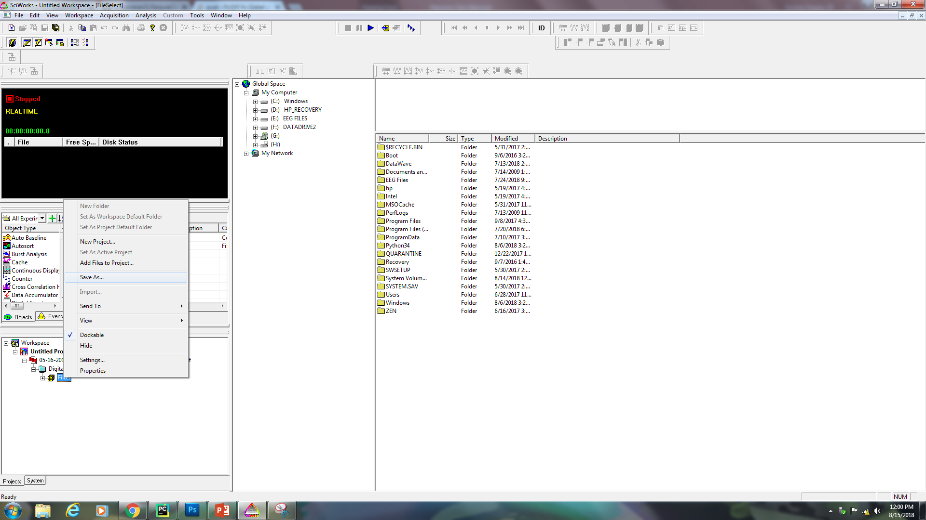
Step 1: Export data from Datawave

Slide 5
Step 1: Export data from Datawave
On [Save as type], select [Text Files]
On [File name], change the file name from *.txt to your own name .txt
Note: it is vital to keep the extension .txt
Change the path to your destination and click [Save]

Slide 6
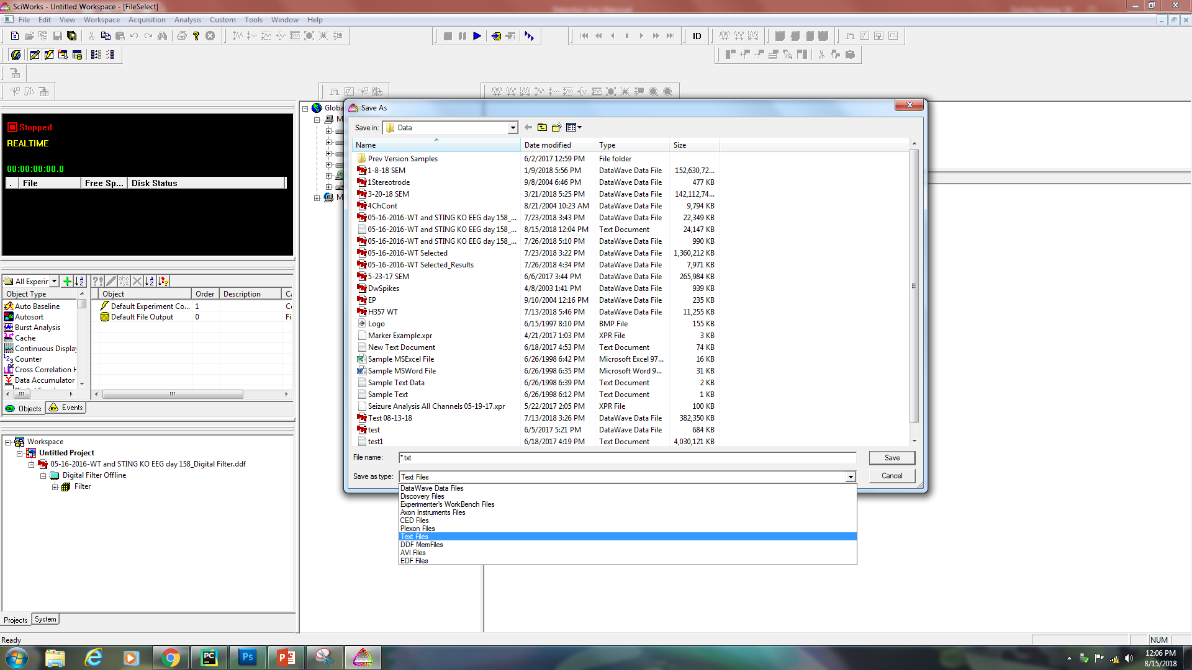
Step 1: Export data from Datawave

Slide 7
Step 1: Export data from Datawave
On [Delimiters], select [Comma]
On [Write Data In], select [Columns]
On [Format], uncheck all the options and do not click on [Skip]
Click [Save]

Slide 8
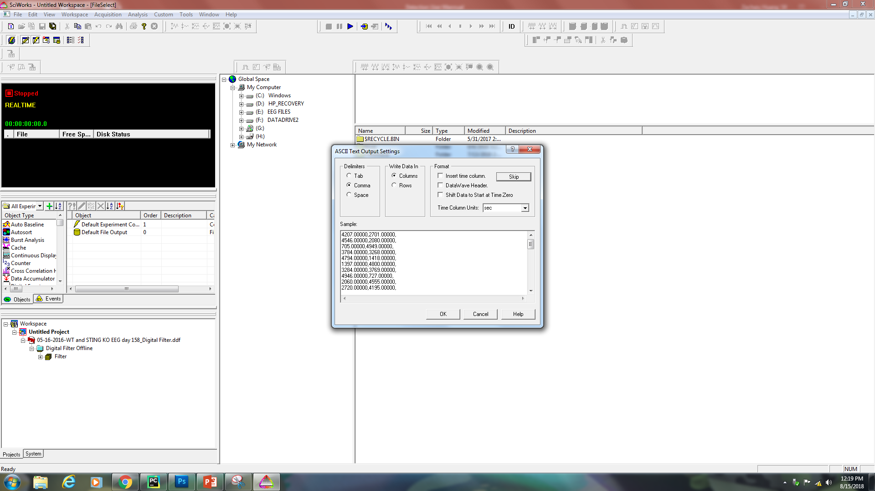
Step 1: Export data from Datawave

Slide 9
Step1.5: Split large data file
Note: For data file which records longer than 1 day, you need to split the data file by day
Click [Start]
On [search] type ‘cmd’
Click on [cmd]

Slide 10
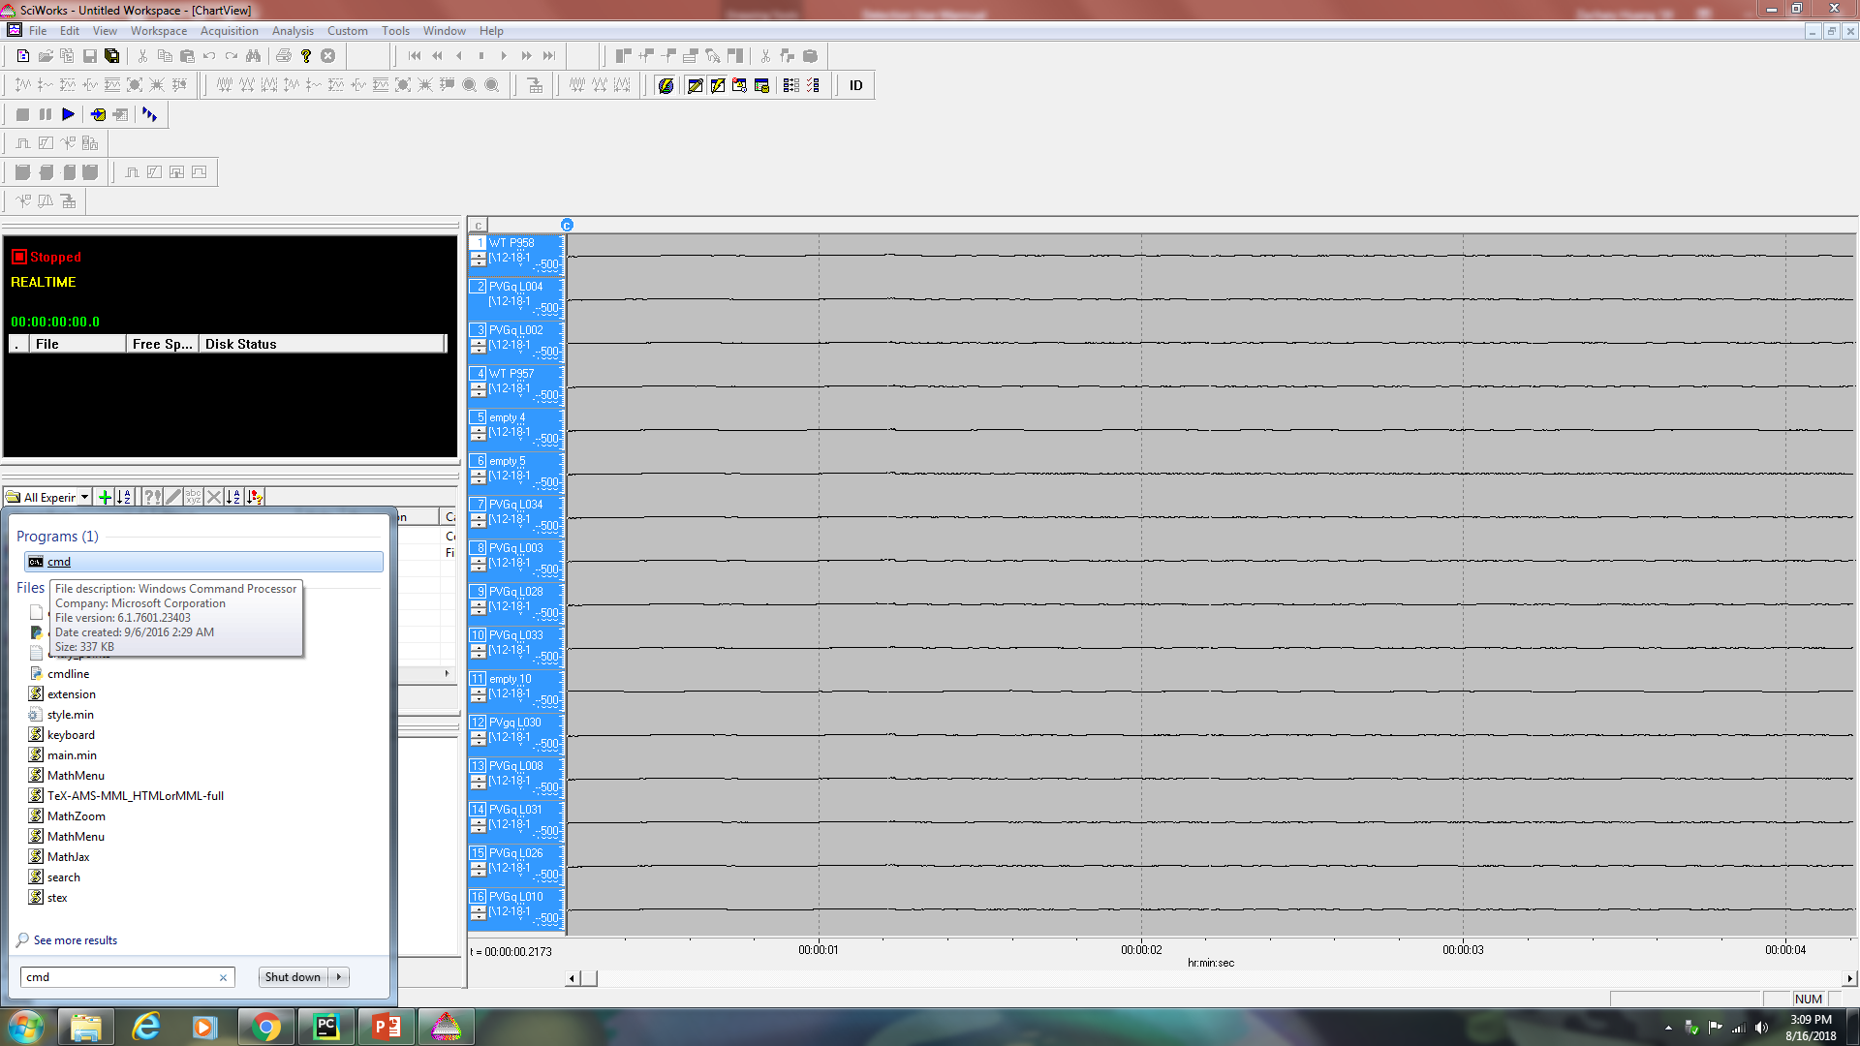
Step1.5: Split large data file

Slide 11
Step1.5: Split large data file
Type ‘split –l 86400 [path and name].txt’
Press Enter
Note: output files will be in the directory named xaa.txt, xab.txt …Those are ordered by date

Slide 12
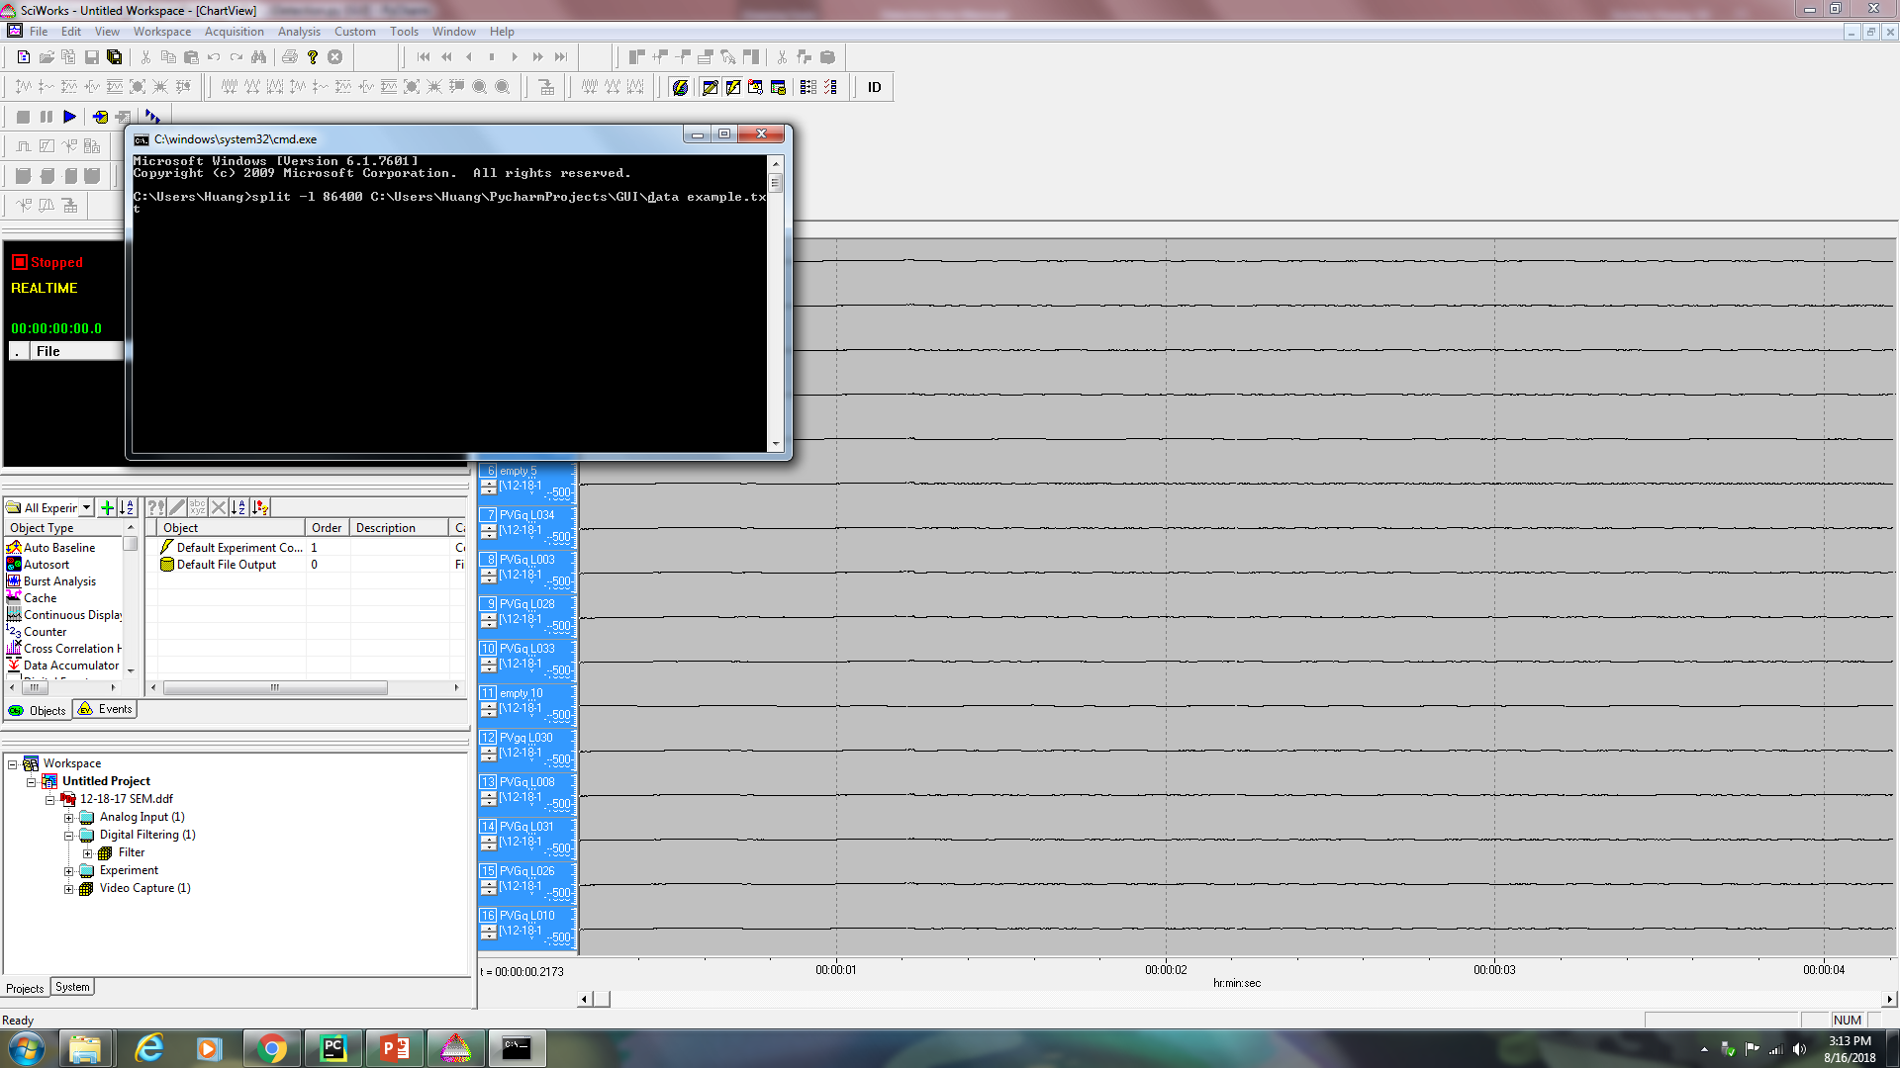
Step1.5: Split large data file

Slide 13
Step2: Create labels for channels
Create/Open a new .txt file
Write down the labels for each channel as the same order in the Datawave
Note: It is crucial to separate each label by comma!
Note: If the labels are not given or not as the same number as in Datawave, the program is ging to auto generate label ‘Channel 0’, ‘Channel 1’, ‘Channel 2’…

Slide 14
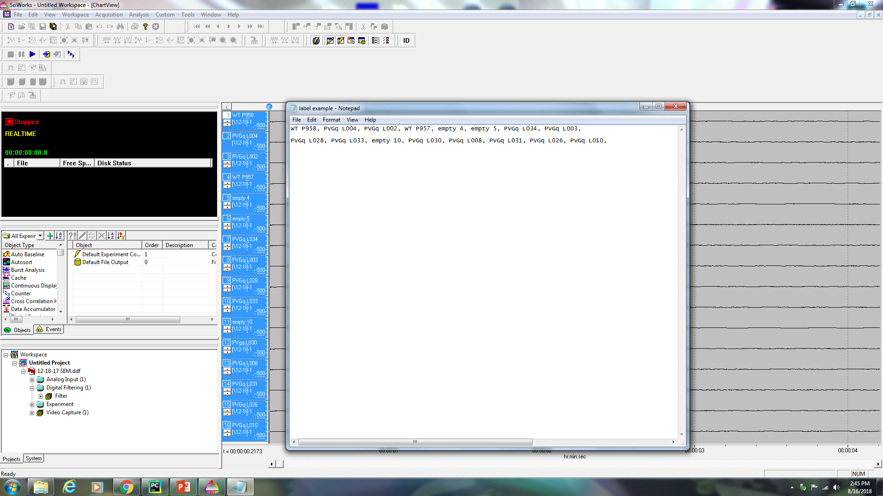
Step2: Create labels for channels

Slide 15
Step3: Open the software
On desktop double click Detection.exe or go to C:\Users\Huang\PycharmProjects\GUI\dist
Note: The program needs some time to initialize
Note: On the bottom right corner, message shows ‘click import to start…’

Slide 16
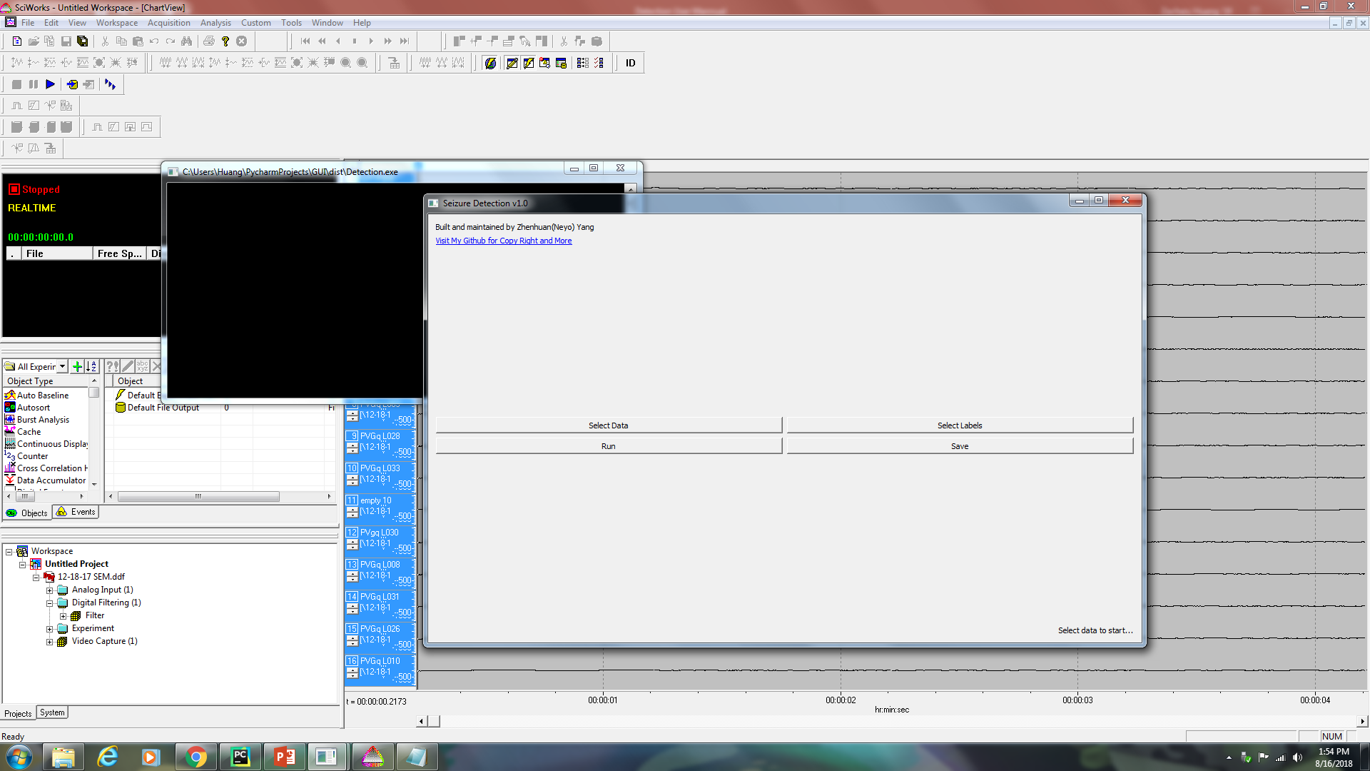
Step3: Open the software

Slide 17
Step4: Select data file
Click [Select Data]
Direct to your data directory, select the .txt file exported from Datawave
Click [Open]
Note: After select the data file, message on bottom right corner change to ‘Data selected!’

Slide 18
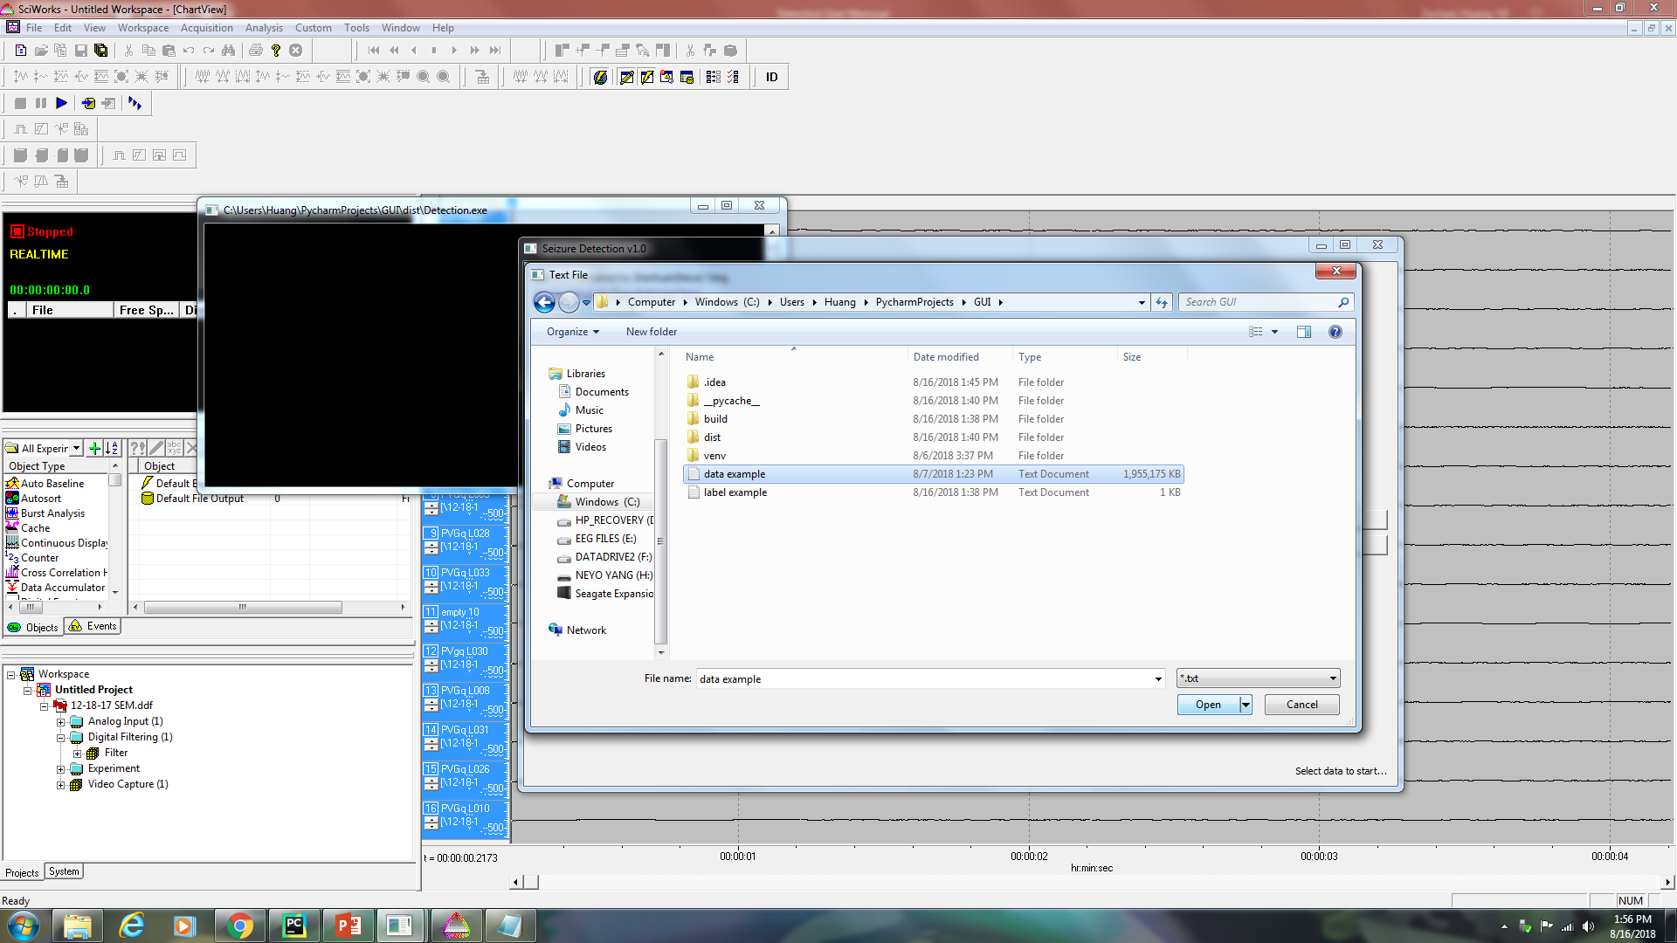
Step4: Select data file

Slide 19
Step5: Select label file
Click [Select Labels]
Direct to your label directory, select the .txt file created by yourself
Click [Open]
Note: After select the label file, message will change to ‘Labels selected!’

Slide 20

Step5: Select label file

Slide 21
Step6: Run the program
Click [Run]
Note: The program needs time to process(e.g. for 1 day 16 channels data, it needs approximately 1 hour). Do not close or click on the program while it’s running!
Note: After the process finished, message will change to ‘Done!’

Slide 22
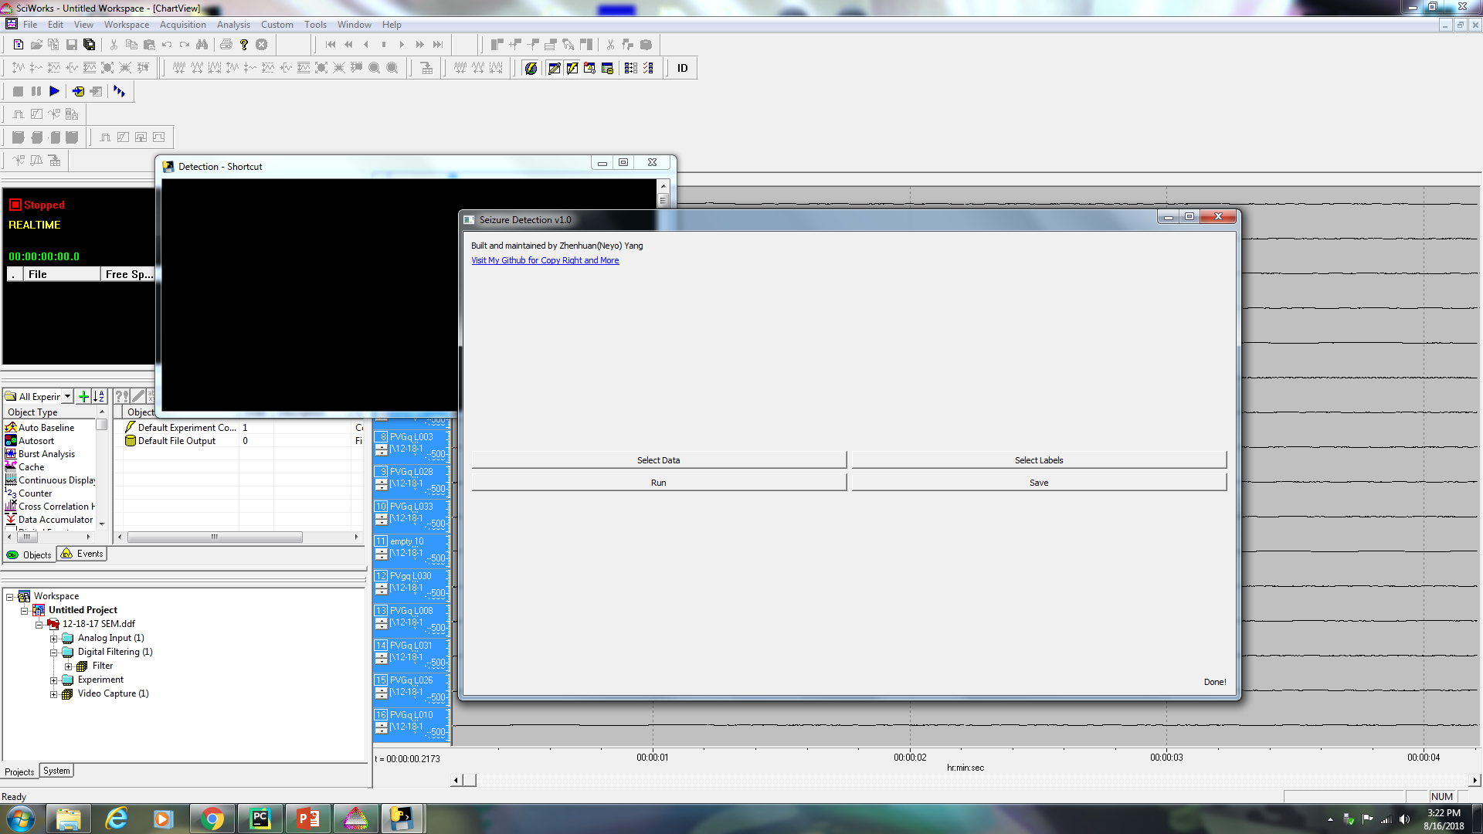
Step6: Run the program

Slide 23
Step7: Save the result
After the process finished, click [Save]
Note: the result will be save to C:\Users\Huang\PycharmProjects\GUI\dist
Note: the result are .pdf of figures. Each file is named after the corresponding label.

Slide 24
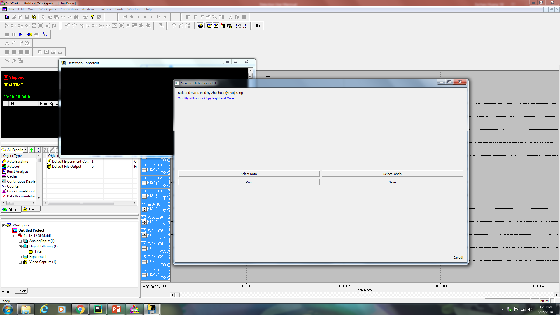
Step7: Save the result

Slide 25
Thank you!

